Slide 1












@centuriton
@centuriton
@centuriton
t.me/centuRITon
www.centuriton.com

Slide 2


IDEA OVERVIEW
APP FOR GOVERNMENT ASSET MANAGEMENT
OPEN INNOVATION
There are 15 lakhs schools in India, plus District/block/cluster level centers, regional offices of the Central Government, etc. Both Central and State Governments need to manage their assets Details of the building such as type, size, area, year of construction, capacity, rooms, labs, maintenance required, etc. should be available along with GIS mapping of location, the present use of the building, etc. An App-based solution is required.
@centuriton
@centuriton
@centuriton
t.me/centuRITon
www.centuriton.com

Slide 3

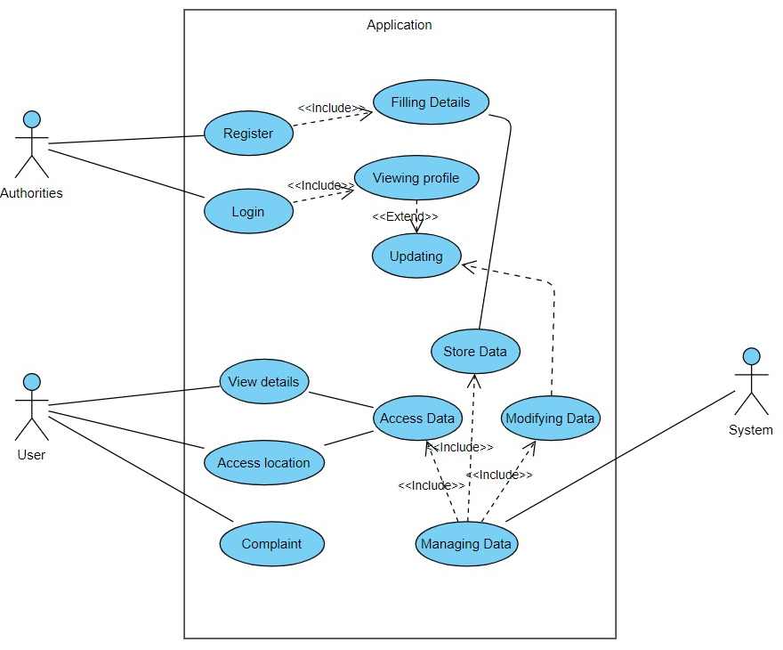

DELIVERABLES
Managing the Data of 15 lakh schools in India, plus District/block/cluster level centers, regional offices of the Central Government, etc., and keeping it updated is a very big challenge for the government. Our application will mainly be focusing on managing educational buildings across the country and empowering the government to improve and develop educational institutions, providing more transparency to the government. Supplying them with more information and assistance to common citizens related to government buildings and giving them the power to help the government to improve the institutions is our other objective.
Use Case Diagram
@centuriton
@centuriton
@centuriton
t.me/centuRITon
www.centuriton.com

Slide 4

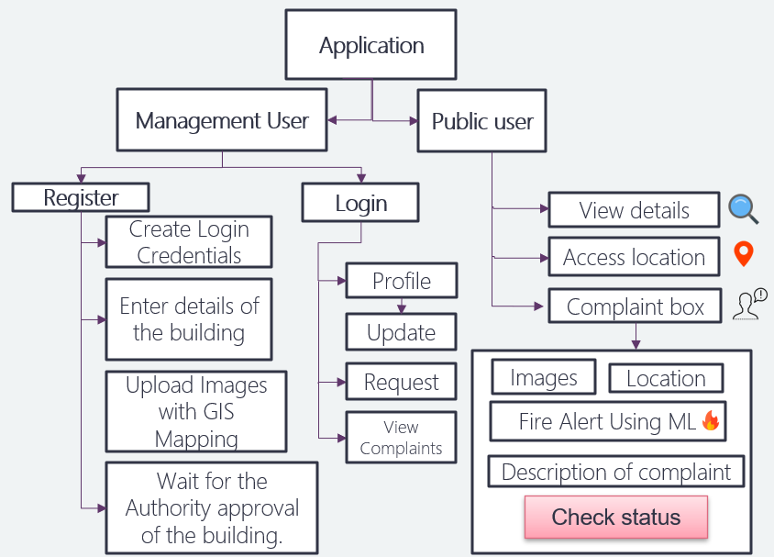
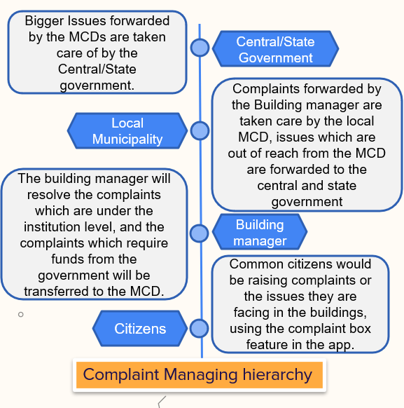
METHODOLOGY/APPROACH
Application Architecture
@centuriton
@centuriton
@centuriton
t.me/centuRITon
www.centuriton.com

Slide 5

TECH STACK
App Development: We will be using Android Studio as an IDE and Kotlin as the programming language to develop our app. Android Studio is the official integrated development environment for Google's Android operating system, built on JetBrains' IntelliJ IDEA software and designed specifically for Android development.
Database: We will be using Firebase as our database for storing the building details and retrieval of information about the educational buildings for the common public. Firebase is a Backend-as-a-Service (Baas). It provides developers with a variety of tools and services to help them develop quality apps, grows their user base, and earn profit. It is built on Google's infrastructure. Firebase is categorized as a NoSQL database program, which stores data in JSON-like documents.
Accessing location: We are converting the address of the building to latitude and longitude using Geopy. Then we can access the location using folium by giving the respective latitude and longitude.
Directions: We will be using Google maps to show the direction to the particular building.
@centuriton
@centuriton
@centuriton
t.me/centuRITon
www.centuriton.com

Slide 6
Unique Features of our App
Our application manages huge data and allows the management to upload details efficiently by the concerned authorities who manage particular regional offices, schools, etc., in each state and district of our country.
User could locate, and check the present status and details of the government buildings.
Complaint Feature in public users allows the citizens to take care of the buildings by reporting the issues to the government and in turn become useful in the development process of the assets of the nation.
Fire alert system using ML detects fire in the building using image recognition through the images uploaded in the complaint box in the public user option and allows the authorities to take faster action on it.
@centuriton
@centuriton
@centuriton
t.me/centuRITon
www.centuriton.com

Slide 7
Basic UI design of our APP
This is the link of the Youtube video in which we have described the UI of our application, please click on the link below :
@centuriton
@centuriton
@centuriton
t.me/centuRITon
www.centuriton.com

Slide 8

TEAM DETAILS
codeMasters
NAME | EMAIL
Naman Chauhan | ch.en.u4aie21030@ch.students.amrita.edu
Riya Tomar | ch.en.u4cse21053@ch.students.amrita.edu
Paritosh Joshi | ch.en.u4cse20149@ch.students.amrita.edu
Shashank Mahato | ch.en.u4cce21031@ch.students.amrita.edu
@centuriton
@centuriton
@centuriton
t.me/centuRITon
www.centuriton.com

Slide 9
Bigger Issues forwarded by the MCDs are taken care of by the Central/State government.
Central/State Government
Complaints forwarded by the Building manager are taken care by the local MCD, issues which are out of reach from the MCD are forwarded to the central and state government
Local Municipality
The building manager will resolve the complaints which are under the institution level, and the complaints which require funds from the government will be transferred to the MCD.
Building manager
Common citizens would be raising complaints or the issues they are facing in the buildings, using the complaint box feature in the app.
Citizens
Complaint Managing hierarchy

